Slide 1
Programming for graphics
Points, Lines and faces

Slide 2
The elements

Slide 3
Euclid’s Postulates
A straight-line segment can be drawn joining any two points.
Any straight-line segment can be extended indefinitely in a straight line.
Given any straight-line segment, a circle can be drawn having the segment as radius and one endpoint as center.
All right angles are congruent.
If two lines are drawn which intersect a third in such a way that the sum of the inner angles on one side is less than two right angles, then the two lines inevitably must intersect each other on that side if extended far enough. This postulate is equivalent to what is known as the parallel postulate.

Slide 4
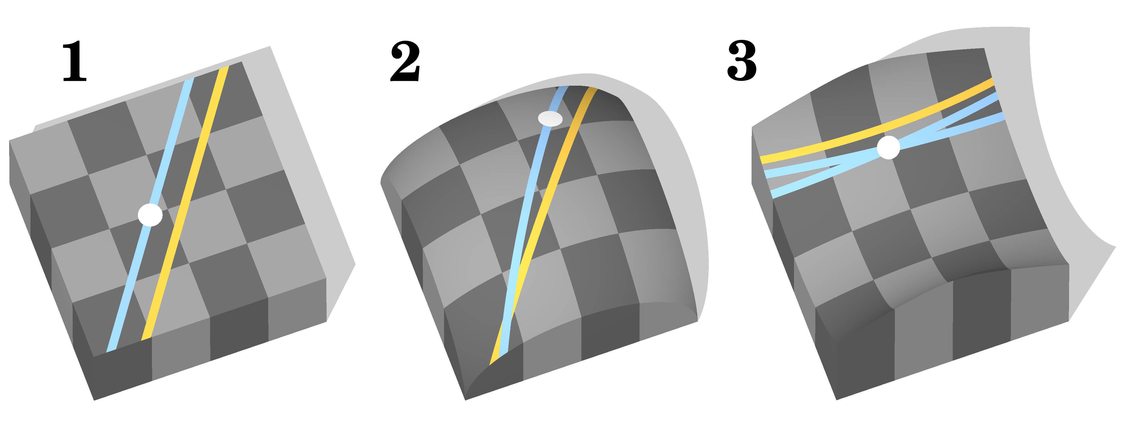
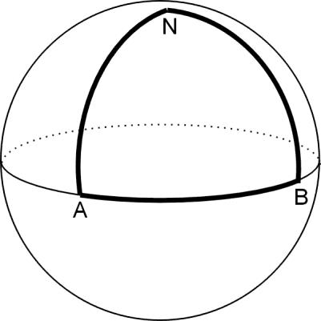
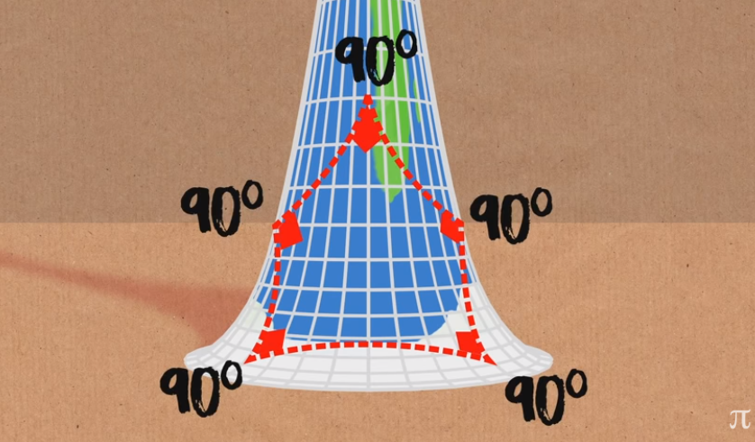

Slide 5
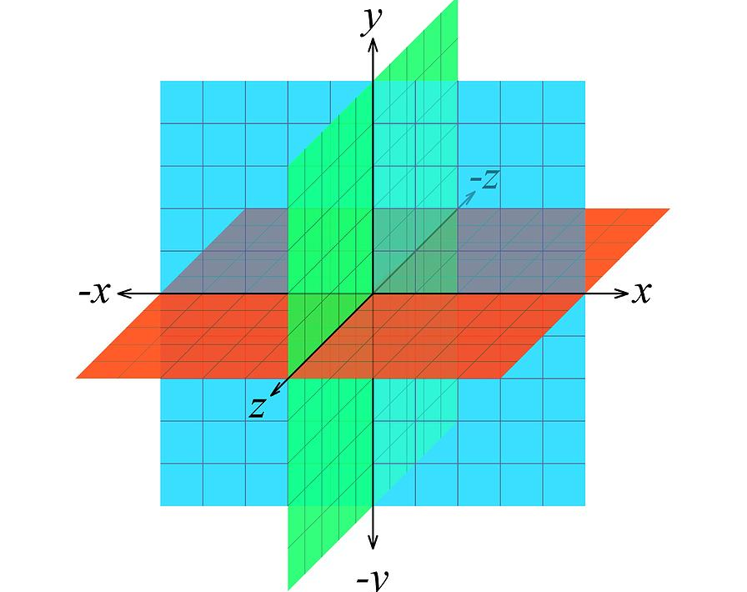
Euclidean space

Slide 6
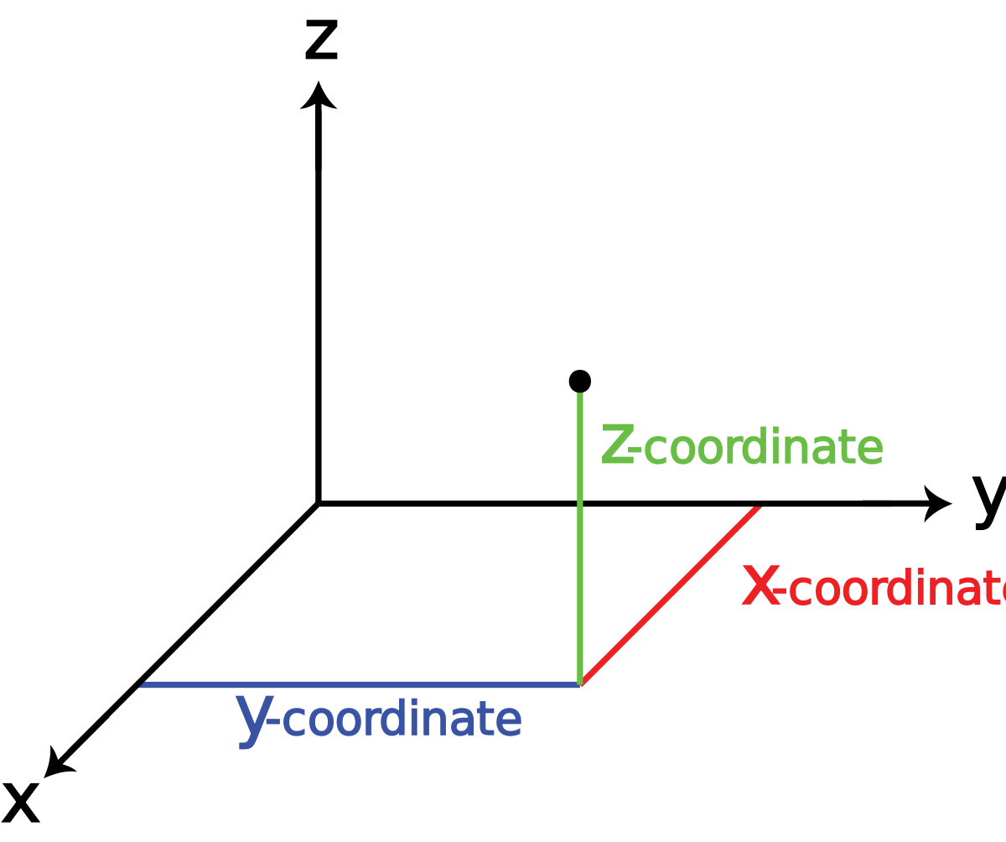
Points
Position in space
Infinity small
In 3D graphics, represented by 3 number [X, Y, Z]
[X,Y,Z]

Slide 7
Lines
The joining of 2 points
Usually in a clockwise order (more on this in a minuet)

Slide 8
Faces
The gap between the lines
With is where we apply colour, once we figure out what the colour will be.

Slide 9
Our triangle

Slide 10
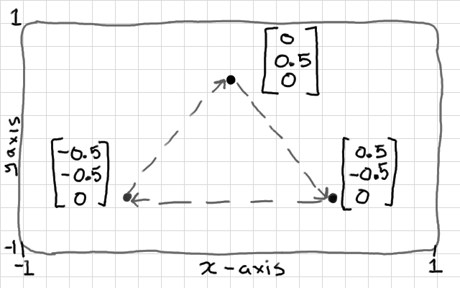
Our triangle
Our first triangle will be defined like so.
Note that position 0,0 would be in screen centre
The order of our points is import
We have to submit our verticies in a clockwaise order or openGL will not draw a face for us.

Slide 11
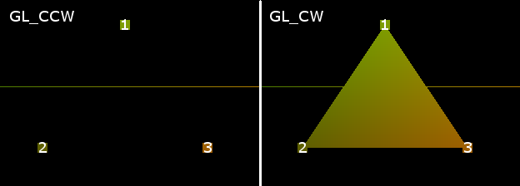
Winding order
By default, openGl uses a clockwise winding order.
This means we have to submit our vertices in a clockwise order or openGL will draw NOTHING!
… well that not strictly true.
If we submit our verts in an anticlockwise order, openGL will still draw us a triangle, it will just be backwards.
Notes:
This is due to the normal direction, a subject we will talk in detail about in the normal mapping tutorial.

Slide 12
Our code

Slide 13
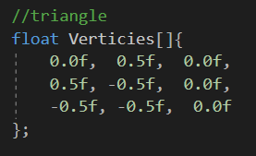
Define some points
We need to define some points for our triangle
We’ll just use an array of floats.

Slide 14
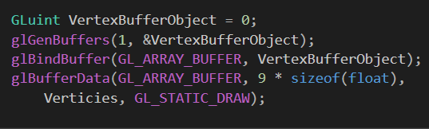
Create a vertex buffer
Create a GLuint to hold a reference to our vertex buffer on the GPU
Gen the buffer
Peramiter 1: the number of buffers to generate
Peramiter 2: the address of the buffer to generate
Bind the buffer to the buffer type
Buffer the data
What kind of data
How big (9 floats * the size of a float in bytes)
The data to buffer
Whether we want to be able to change the data (normally no, so we use static).

Slide 15
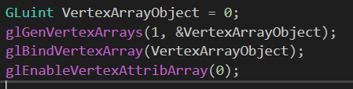
Create a vertex array object
Use a GLuint as a reference to the vertex array object in GPU memory
Generate the vertex arrays
Bind the vertex array object for use
Assign the position data to attribute 0 in the shader (what dose this mean? Don’t worry about it. We’ll cover shaders later).
Notes:
We an use vertex arrays for more than just point information, more on this in coming lectures.

Slide 16

Bind vertex buffer object
Bind the vertex buffer object (the thing with out point data in it) for use
Tell openGL what kind of data we are passing
Start binding the data from element 0
The data should be chunked up in to sets of 3 floats
Set the data type to float
Normalize the data for us? False
Size of the stride = 0, specifies the byte offset between vertex points. Useful later for now, we need 0.
pointer to the first component of the first generic vertex attribute in the array. NULL because we don’t want one.
Activate the vertex array a position 0
This is a safety thing, think of it as unbinding the current active array.

Slide 17
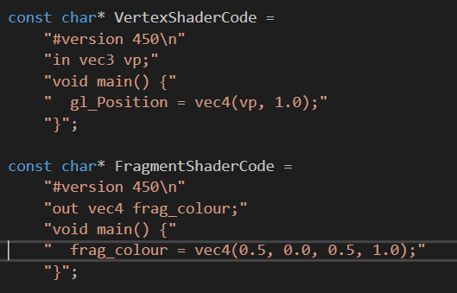
Write shader code
MAGIC!
This step is, like so many, important and can not be skipped but we will talk more about them soon.
For now, just accept that you need these. Without them, openGL will not know what to do with the vertex data we just gave it

Slide 18
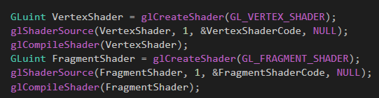
Linking and compiling the shaders
We create a Gluint to a shader of type GL_VERTEX_SHADER, called VertexShader
We link VertexShader to the VertexShaderCode using glShaderSource
Then we call glCompileShader passing VertexShader as an argument.
We then do the same for the fragment shader BUT MAKE SURE TO PASS THE FRAGMENT SHADER OBJECT AND CODE!

Slide 19

Connect the shAders to a shader program
We create an Gluint, ShaderProgram using glCreateProgram. This will be where we connect our vert and frag shader in to one program, ready to use.
We attach the vertex shader to the shader program using glAttachShader
And do the same for the fragment shader
Since we defined the shader type in the previous code, glAttachShader will know which shader is which and process them accordingly.
Note: a shader can be used in several program.

Slide 20
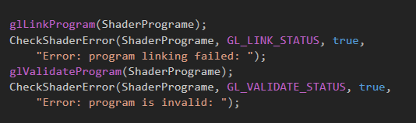
Link and validate the shader program
Now we need to link the shader program and check it for link errors.
if we detect a link error, we will print a helpful message
If the linking was successful We validate the program
If the validation fails we print an helpful message

Slide 21
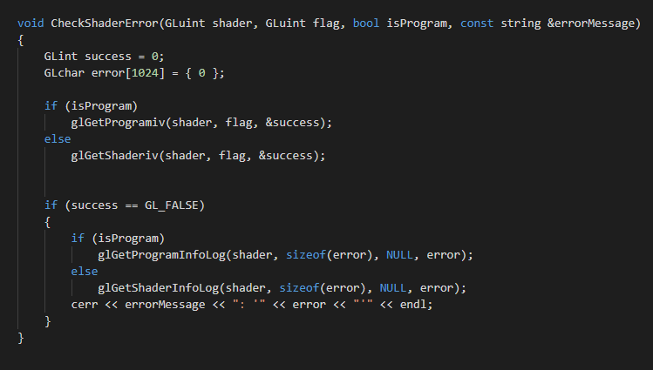
Side note!
Check shader function looks like this
It will print any shader compiler/linker errors to the console.

Slide 22

Set clear colour and view port
You’ve see this before.

Slide 23
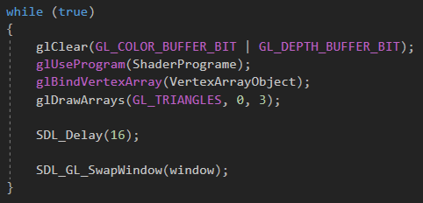
The main loop
After clearing the colour and depth buffers
Call glUseProgram, passing in our shader program
Call glBindVertexArray, passing in our vertex array object (the thing will all our point data in it)
Call glDrawArrays, telling it to draw triangles, starting at element 0 and the number of Indices to draw
Delay for 16 milliseconds
Swap window

Slide 24
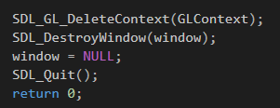
Clean up
Event though our program doesn’t exit the while loop properly, its still good practice to clean up.

Slide 25

Compile and run the code!

Slide 26
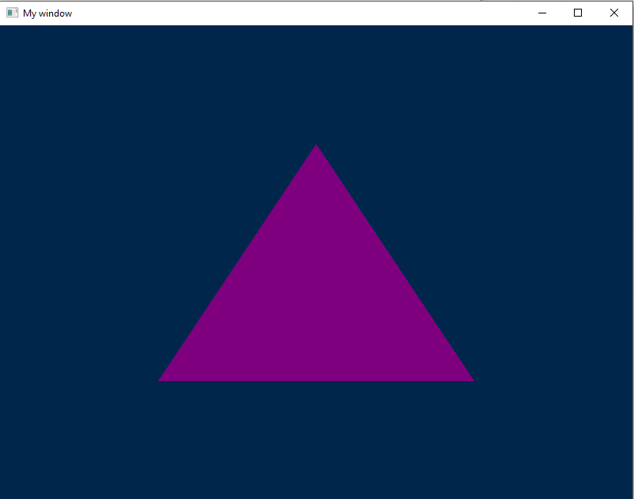
What you should see
Something like this!

Slide 27
NEXT
Change the colour of the triangle
Move the triangle to a different position
Can you draw 2 triangles?

Slide 28
Questions?

